Slide 1
Introduction to Software Technical Practices
Matt Plavcan
Intel Emergent Systems
Notes:
About the class:
Advancing the software professional community through dedication to practicing software development and continuous learning. This workshop introduces principles of disciplined engineering as a standard for professional programmers. Attendees will learn and practice techniques for highly-effective software development, including source control, continuous integration, Test-Driven Development, and refactoring.

Slide 2
Schedule
Morning:
Introduction
Source Control
Code Convention
Continuous Integration
Pairing
Refactoring
Afternoon:
Lunch
Refactoring
Unit Testing
TDD
Advanced Practices
Closing

Slide 3


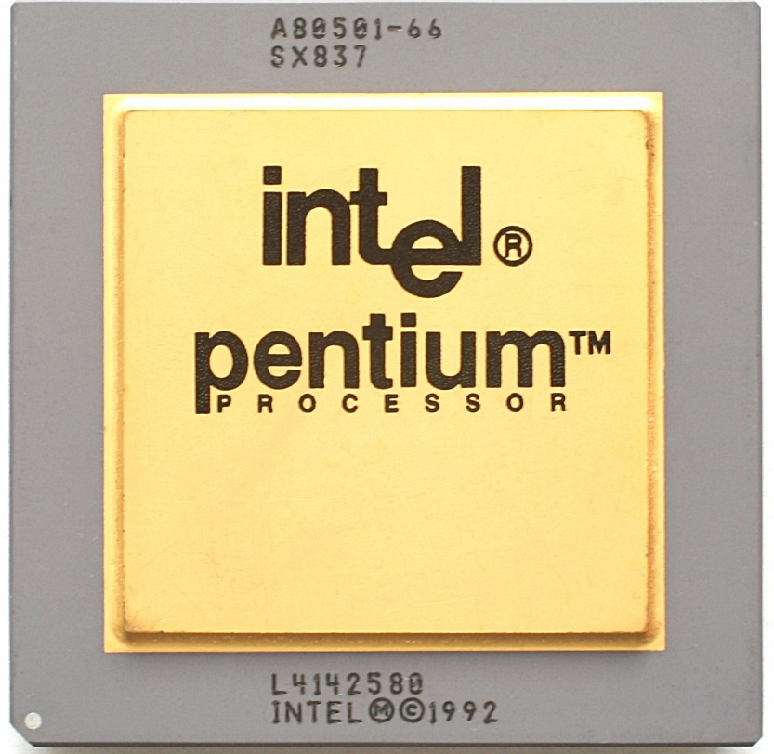


Cost of Defects
Notes:
Mars Climate Orbiter(English/metric) 1999: $193M / + Polar Lander $357M https://en.wikipedia.org/wiki/Mars_Climate_Orbiter https://en.wikipedia.org/wiki/Mars_Polar_Lander
ESA Ariane 5 (64-bit float converted to 16-bit int) 1996: $500M https://en.wikipedia.org/wiki/Cluster_(spacecraft)#Launch_failure
Knight Capital (Re-use of “deprecated” bit in data structure) 2012: $440M https://pythonsweetness.tumblr.com/post/64740079543/how-to-lose-172-222-a-second-for-45-minutes
Heartbleed (SSL heartbeat security exploit) 2014: $500M? https://heartbleed.com/ https://en.wikipedia.org/wiki/Heartbleed
Intel FDIV (Floating point divide lookup table bad entry) 1994: $475M https://en.wikipedia.org/wiki/Pentium_FDIV_bug

Slide 4
Why Technical Practices?
There is a large variation in the ways to implement software
A EE/CS degree does not impart all the knowledge necessary to do the job (It does lay a strong foundation.)
Peers are your best source of education and feedback

Slide 5
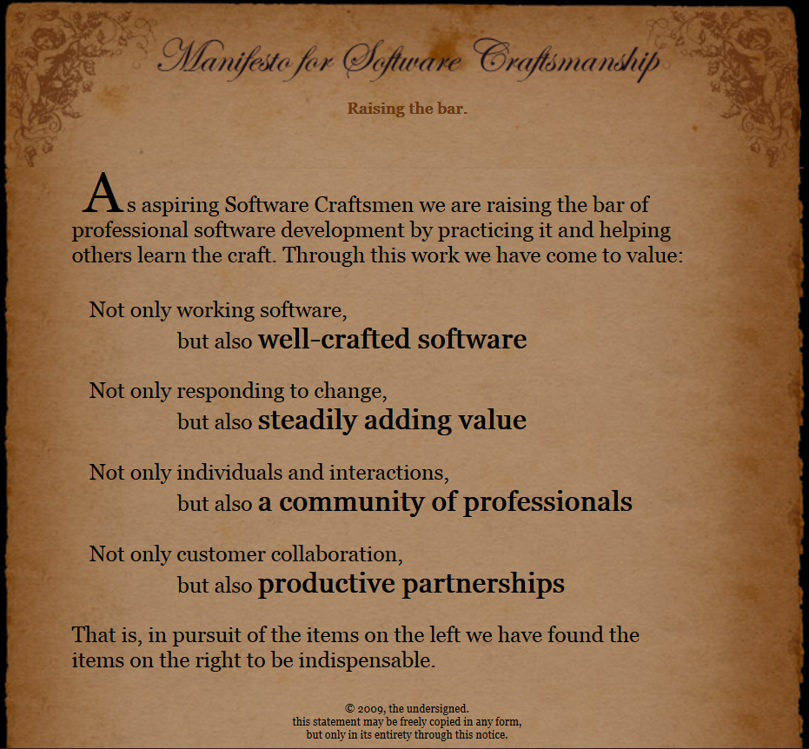
Notes:
The Manifesto for Software Craftsmanship can be found at: http://manifesto.softwarecraftsmanship.org/

Slide 6
What Does that Mean?
Exhibiting work discipline
Practicing to learn your craft
Commitment to continuous learning
Working with others to exchange knowledge

Slide 7
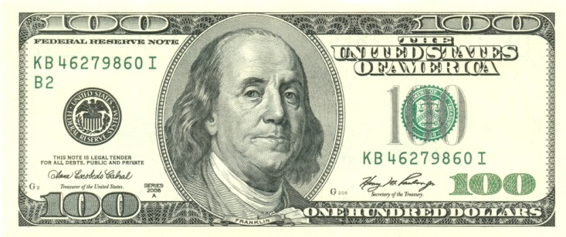

No Really, Why Do It?
Notes:
Mastery = time, usable to improve career or relationships

Slide 8
False Dichotomy
“I can do it right, or I can do it fast”
Goal: On Time, Quality Product
RIGHT
FAST
RIGHT
FAST
Notes:
Classic Iron Triangle is : “Fast Good Cheap: Choose Two” (Good => Quality, which is a variable option)
Modern Iron Triangle is : “Scope, Time, Resources” (Quality is invariant, reflecting high standards of development team)

Slide 9
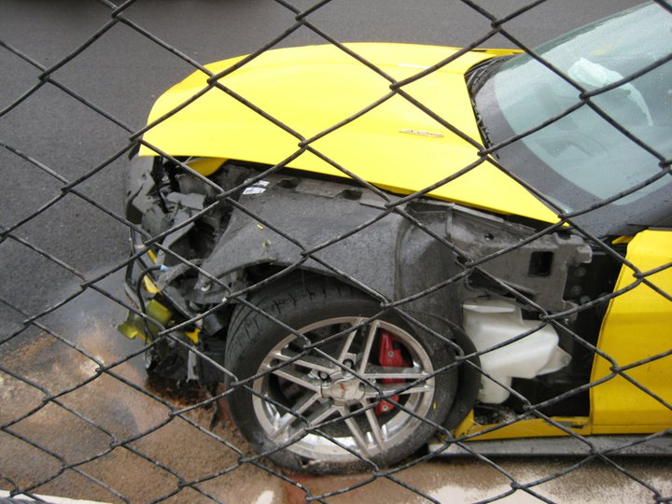
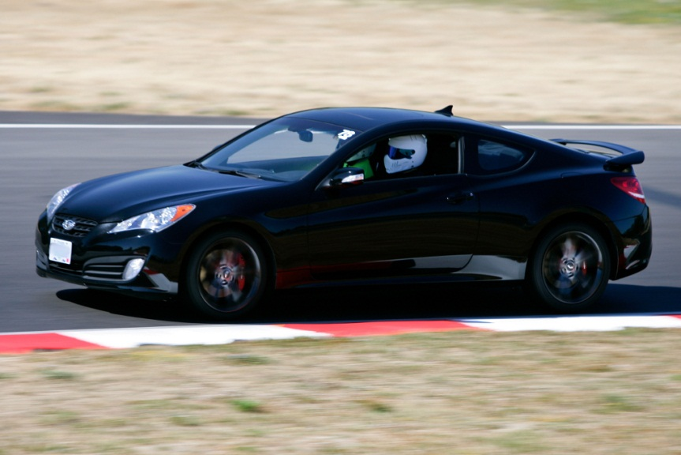
Slow is Fast?
Speed without control leads to unpredictability
Disciplined execution leads to repeatable results, with an increase in velocity over time
Notes:
Tell Driver Training experience story. (Corvette Z06, $75K->0 in 4 seconds)

Slide 10
Software Development Practices
Layered Testing
Testing and Deployment
Test-Driven Development
Coding Techniques
Customer Feedback
Team Organization and Planning
Automation
Continuous Integration
Source Control
Retrospectives
Colocation
DevOps
Notes:
It’s much easier for a team to agree on team-wide practices for activities like testing, because they are typically introduced to coders during their first project. There’s no previous practice in place that must be overridden or unlearned.

Slide 11
Coding Technical Practices
...
Short Iterations / Continuous Delivery
Pair Programming / Continuous Review
Collective Code Ownership
Test Driven Development
Refactoring
Unit Testing
Continuous Integration
Common Code Convention
Revision Control
Behaviors
Tools, Processes, Behaviors
Notes:
Proficiency in the lower practices in the stack serve as a foundation for higher practices

Slide 12
Adoption Rates for Agile Teams
24%
21%
27%
34%
36%
65%
50%
43%
99%
Short Iterations / Continuous Delivery
Pair Programming / Continuous Review
Collective Code Ownership
Test Driven Development
Refactoring
Unit Testing
Continuous Integration
Common Code Convention
Revision Control
Notes:
2014 Survey at http://www.versionone.com/pdf/2014-state-of-agile-survey.pdf

Slide 13
Revision Control
definition: The management of sets of changes to files, such that multiple versions can be recalled, attributed, inspected, and combined

Slide 14
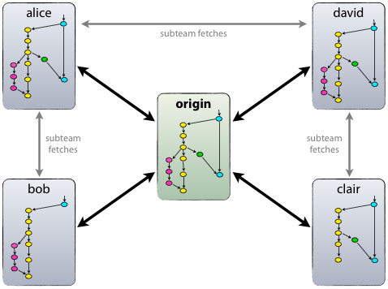

Distributed Revision Control

Slide 15
Revision Checkin Behavior
Develop on a branch
Check in often (every 15 minutes)
Squash comments before merge (when necessary)

Slide 16
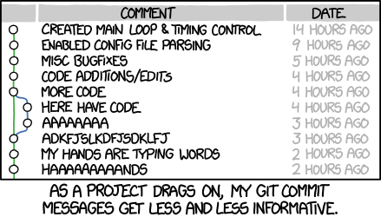
Revision Comment Behavior
Notes:
Creative Commons: http://xkcd.com/1296/

Slide 17
Common Code Convention
definition: A collective documented agreement between developers detailing the organization, structure, principles, and practices for creating a common work.

Slide 18
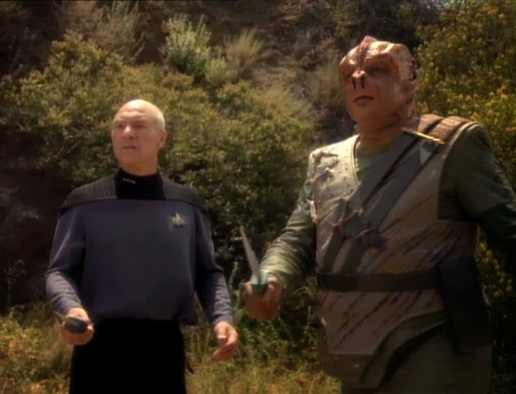
DARMOK AND JALAD
at Tanagra.
Notes:
https://en.wikipedia.org/wiki/Darmok

Slide 19
Code Quality
Maintainability
Portability
Reliability
Efficiency
Complexity
Security
Documentation
Legal, Standard, or Certification Compliance

Slide 20

Product Documentation
Product Life Cycle
Release Cadence
Activities
Team Structure
Product Architecture Specification
Behaviors
Modules
Layers
Interfaces
Protocols
Coding Convention
Language
Complexity
Implementation
Style
Tools

Slide 21
What goes in a Code Convention?
Create Your Own Document:
Web Application: Online ticket sales for soccer
Timebox: 5 Minutes

Slide 22
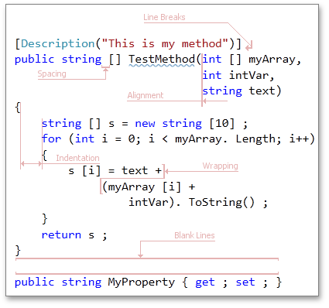
Code Convention
Notes:
It’s not about the formatting.

Slide 23
Common Code Convention
Sample items:
Program organization
File structure
Naming of all things
Heuristics
Style
Formatting
Review Process
Pairing Behavior
Environment
Tools
Properties:
Clear
Concise
Consistent
Collaborative

Slide 24
Code Convention Behavior
Convention is a social contract
Enforce via code review (not via tools)
Violate guidelines when reason dictates

Slide 25
Continuous Integration
definition: the practice of merging all developer working copies with a shared mainline several times a day.

Slide 26
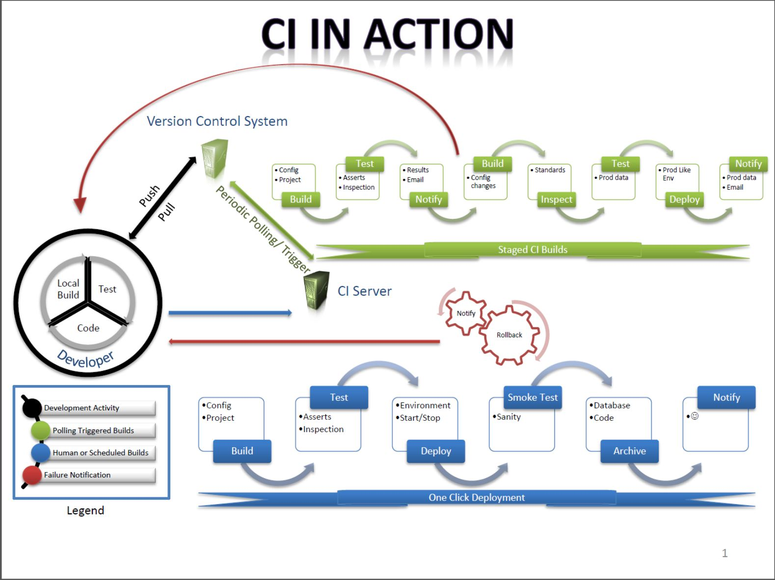
Continuous Integration Process
Notes:
Ignore the content in this slide: The tool and the process is not where teams fail CI, it’s in the behavior.

Slide 27
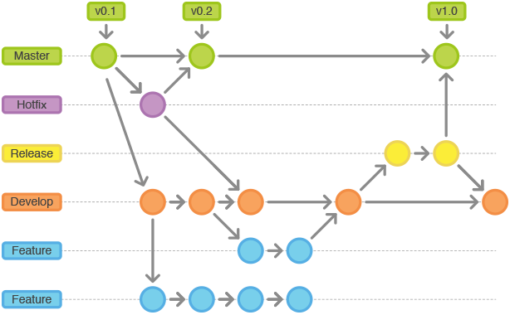
Revision Branch Behavior
Notes:
Successful CI relies on short lived branches and pull behavior. Branching is tied to source control behavior and program structure.
http://nvie.com/posts/a-successful-git-branching-model http://www.atlassian.com/git/workflows#!workflow-gitflow
http://danielkummer.github.io/git-flow-cheatsheet

Slide 28
Continuous Integration Behavior
Focus on a small section
Make incremental changes
Add/Run unit tests frequently
Commit code when passing
Pull from main trunk immediately
Extract
Test
Commit
Pull
Refactor
Notes:
Clean code’s no good if it’s not deployed. Make changes small, commit often to show progress and expose bugs early.
Pulling from/pushing to the master repo is key to having successful CI
Also, this makes others aware of the changes you’re making, and prevents them from breaking your modules further.

Slide 29
Break

Slide 30
Legacy Code
definition: Code which has no tests to guard it from breaking

Slide 31
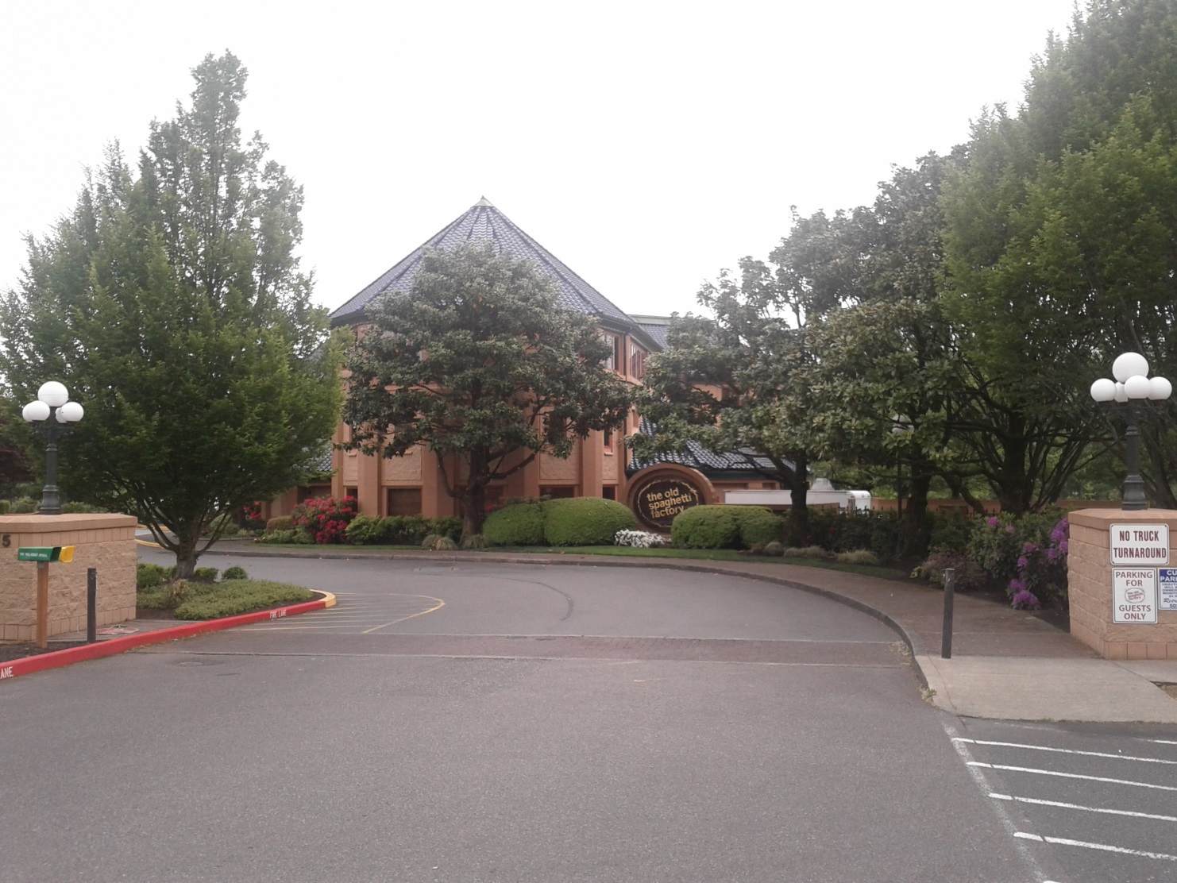
Cause: Original Authors
Notes:
We’d like to blame others for the horrible code we deal with, but how do we rationalize the code we give to others?

Slide 32
Technical Debt
definition: A design or construction approach that's expedient in the short term but that creates a technical context in which the same work will cost more to do later than it would cost to do now

Slide 33
Technical Debt
“Shipping first-time code is like going into debt. A little debt speeds development so long as it is paid back promptly with a rewrite... The danger occurs when the debt is not repaid. Every minute spent on not-quite-right code counts as interest on that debt. Entire engineering organizations can be brought to a stand-still under the debt load of an unconsolidated implementation, object-oriented or otherwise. The concept does not mean that debt should never be incurred. Just as leverage can help a company when used correctly, a quick solution can mean a faster time to market in software development. In addition, technical debt is not just poor code. Bad code is bad code, and technical debt can result from the work of good programmers under unrealistic project constraints.“ – Ward Cunningham
Notes:
http://c2.com/cgi/wiki?WardExplainsDebtMetaphor

Slide 34
What is Technical Debt?
Visible to Customer
Bugs
Technical Debt
Features
Architecture
Negative Value
Positive Value
Invisible to Customer

Slide 35
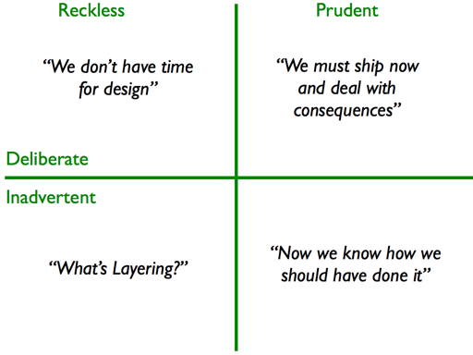
Forms of Technical Debt
Notes:
Martin Fowler – “Software Design in the 21st Century”
https://youtu.be/8kotnF6hfd8?t=2930

Slide 36
Pair Programming
definition: Two programmers creating code collectively using a single computer

Slide 37
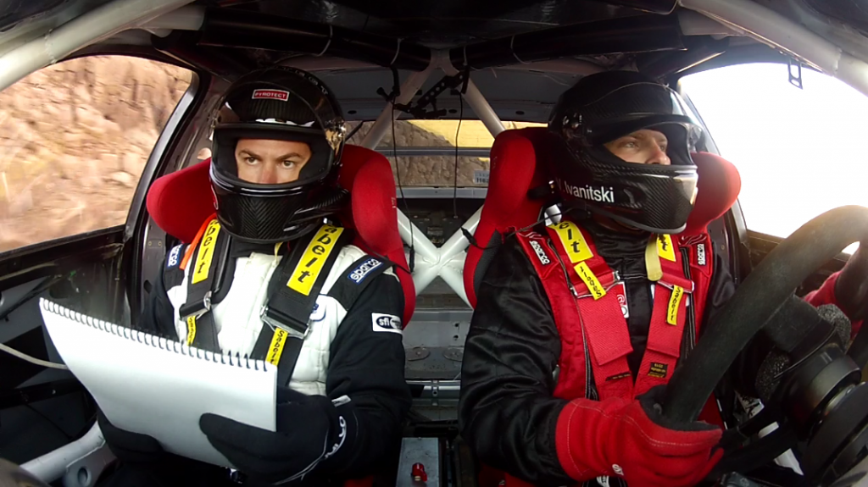
Pair Programming
Roles:
Driver
Navigator
Advisor (>2 coders)
Styles:
Time Slot
Ping-Pong
Ball & Board

Slide 38
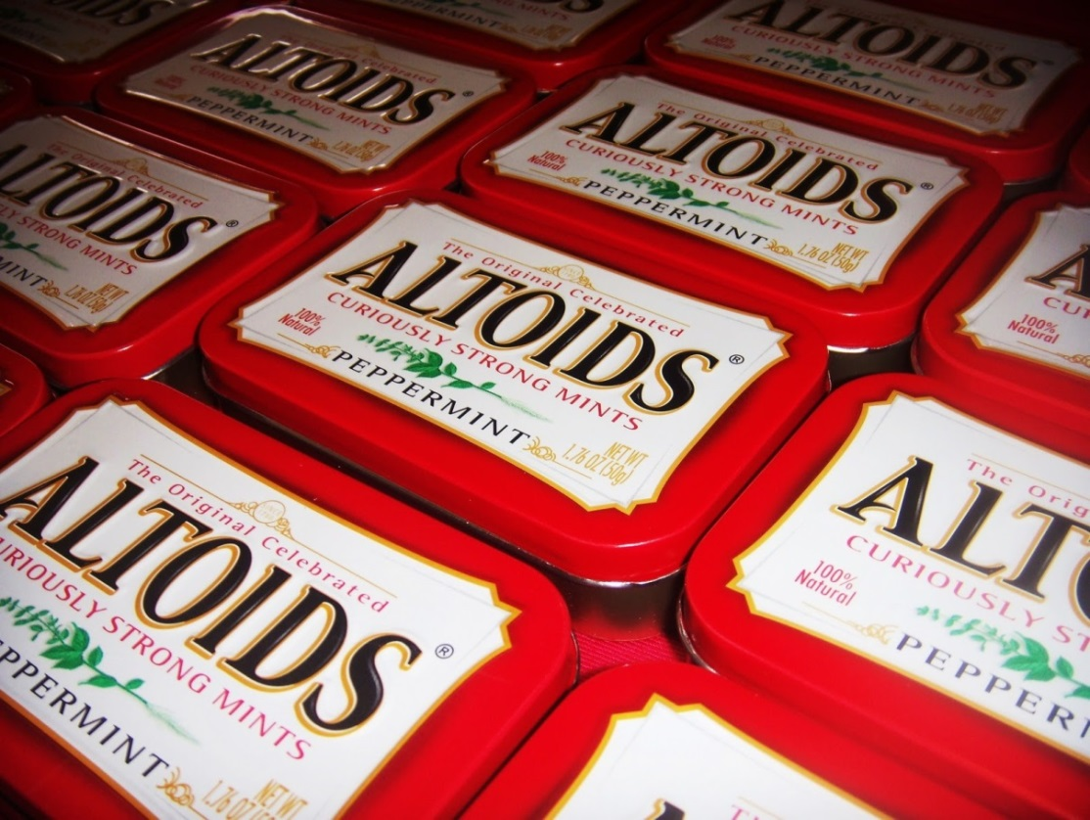
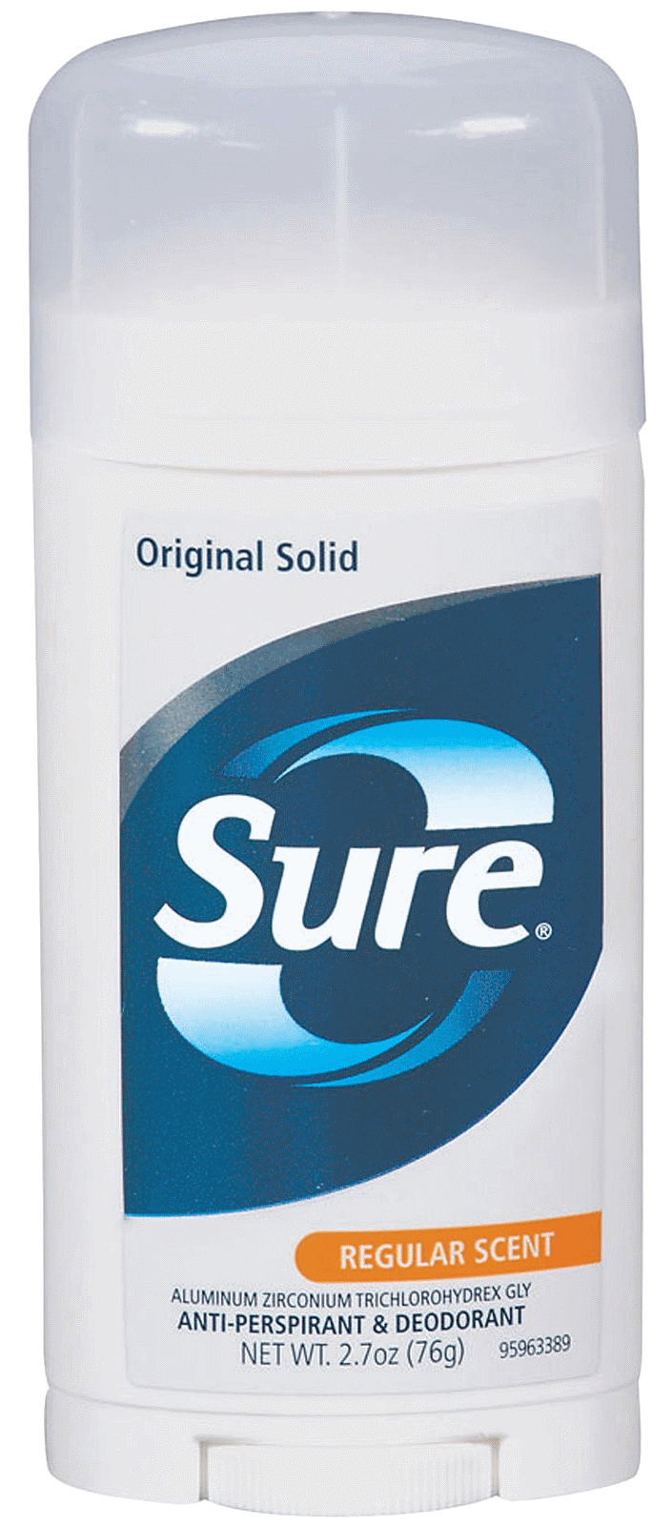

Pair Programming Tools

Slide 39
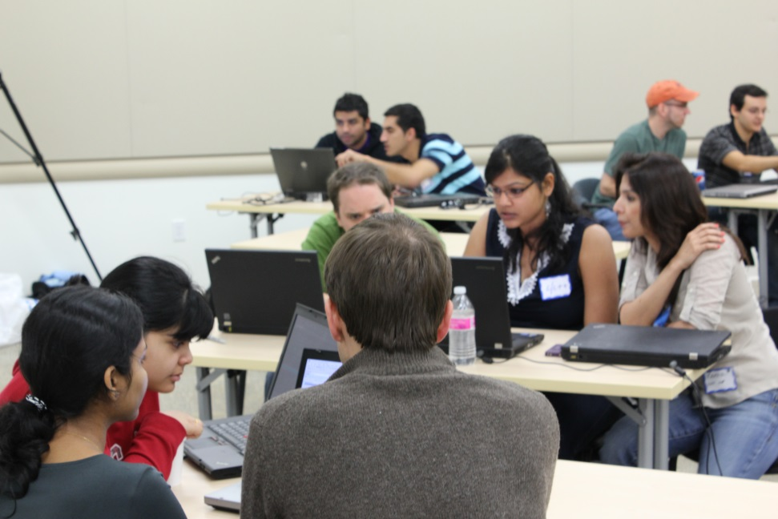
Pairing / Collective Ownership
Design knowledge spread among the team
Better software design
Fewer defects
Diffusion of skills and techniques
Notes:
Not owning the code means the code doesn’t own you.

Slide 40
Break

Slide 41

Code Cleanup Exercise
First Pass: “Clean Up Code”
No Restrictions
https://github.com/emilybache/Tennis-Refactoring-Kata http://goto/tenniskata
Notes:
http://github.com/emilybache/Tennis-Refactoring-Kata http://goto/tenniskata

Slide 42
Refactoring
definition: Reorganizing code while preserving its original behavior.
Notes:
Rearrange code until blocks are grouped reasonably
Many times, removing code has no effect on the overall behavior
Even better: Sometimes, removing Code can add functionality!

Slide 43
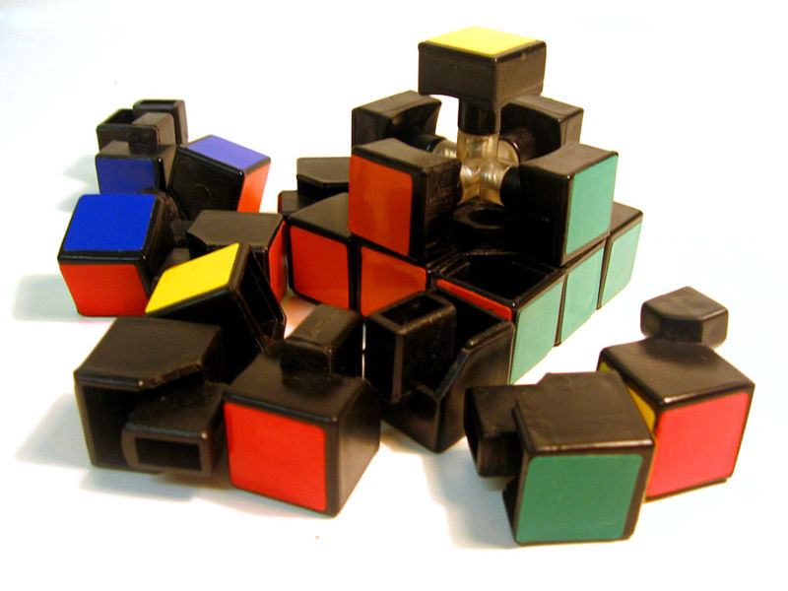
REFACTORING
When Adding A New Feature Isn’t An Option Right Now.

Slide 44
Single Responsibility Principle
definition: Code should only have a single reason to change.

Slide 45
Single Responsibility
Code should only have a single reason to change. This applies to:
Classes
Methods
Data objects
Code that has multiple responsibilities should be split into multiple parts. Caveat: Still must avoid duplication, parallel hierarchies Smells:
Large Class
Feature Envy
Primitive Obsession
// The “And” in the name is // a dead giveaway:
// This method does two things!
void findItemAndInsertIntoDataBase( DBObject object,
List<DBObject> incoming_items,
backendDb server)
{
int search_index = incoming_items.lastIndexOf(object);
if(search_index <= incoming_items.size()) {
DBObject item = incoming_items.get(search_index);
server.insertRecord(item);
} }

Slide 46
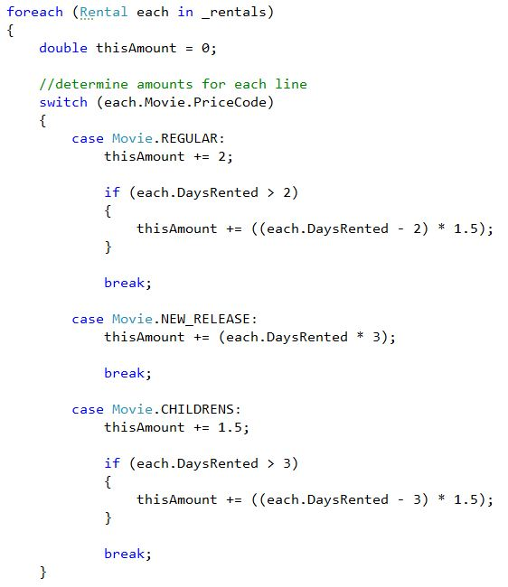
Refactoring: Extract Method
When you have a code fragment that can be grouped together – Move that fragment into a method whose name explains its purpose.
Extract switch statement into method called GetAmount()
Notes:
Exercise 01

Slide 47
Refactoring Exercise
Second Pass: “Extract ‘til You Drop”
Only Extract Method
https://github.com/emilybache/Tennis-Refactoring-Kata http://goto/tenniskata
Notes:
Extract Method
http://github.com/emilybache/Tennis-Refactoring-Kata http://goto/tenniskata

Slide 48
Break

Slide 49
Code Smells
definition: Indications that code may be broken, or likely to break.

Slide 50

CODE SMELLS
If It Stinks, Change It.

Slide 51
Common Code Smells
Duplicated code
Excessive use of literal values
Excessively Short Names
Dead Code
Excessively Long Names
Excessive Comments
Long Methods
Long Parameter List / Data Clumps
Class does too much (Large Class)
Class does too little (Lazy Class)
Method mixes high and low-level concepts (Primitive Obsession)
Method uses an overly elaborate algorithm (Unneeded Complexity)
Method uses data only from other classes (Feature Envy)
Code defends itself from its neighboring classes (Paranoid Code)
Class touches private members of other classes (Inappropriate Intimacy, Indecent Exposure)
Classes must be extended together (Parallel Inheritance Hierarchies)
Class overrides base class method such that it violates the base class’s specified behavior (Refused Bequest)
Notes:
http://sourcemaking.com/refactoring/bad-smells-in-code
http://blog.codinghorror.com/code-smells/
http://refactoring.guru/catalog
http://www.industriallogic.com/blog/smells-to-refactorings-cheatsheet/

Slide 52
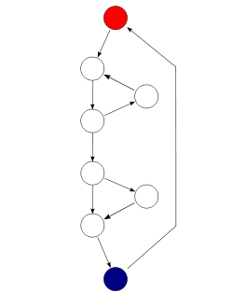
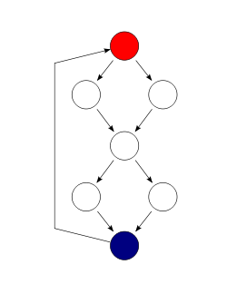
Cyclomatic Complexity
When a method gets too large, the number of pathways through it usually increase.
The Cyclomatic Complexity Number describes the total number of paths through a function.
CCN= (# of decision points) - (# of exit points) + 2
Methods with a CCN > 6 should probably be broken down into sub-functions; They are likely difficult to test. Possible exception: ‘switch’ or ’case’ statements

Slide 53
Code Smells: Complexity
Break complex functions down into smaller sub-parts.
Use Intent-Revealing Names to document expected interactions and behavior.
This function is likely untestable.
A “Saw-tooth” is a good indication that code is too complex to maintain.
int touchEverything(record[][] record_list) {
int i,j,k, count;
for(count=0, i=0; i < record_list.length; i++) {
for(j=0; j < 20; j++) {
if(record_list[i][j].counter > 0) {
for(k=record_list[i][j].ctr; k > j; k--){
if(record_list[k][j].value > record_list[i][j].value) handleRecord(record_list[k].value);
}
} }
}
}

Slide 54
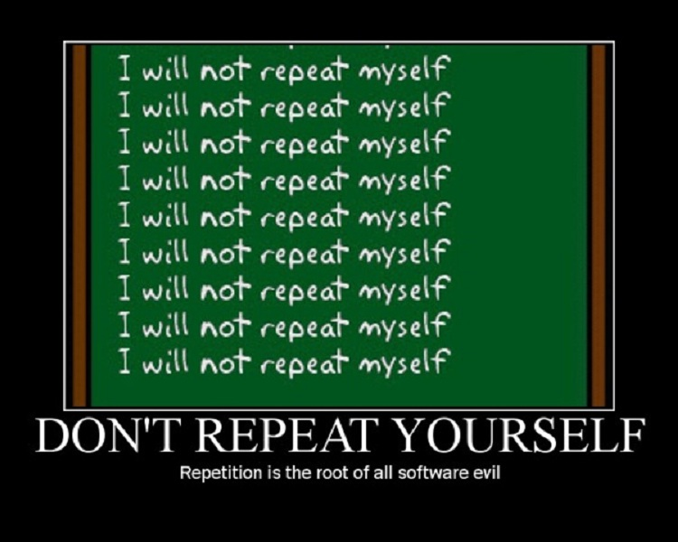
Notes:
http://en.wikipedia.org/wiki/Don%27t_repeat_yourself

Slide 55
Code Smells: Literal Repetition
Using literal values is the most common form of duplication. When one value changes, all must change. But:
What if a replacement is missed?
What if two different behaviors use the same literal value?
What about calculations based on those values?
Also known as: “Magic Numbers”
Solution is to use Constant Values with Intent-Revealing Names to document code
class ConfusedReactor { int[5][6] grid_array;
boolean criticalMass(int search_item) {
int row = 5;
while(channel > 0) {
int x, sum=5;
for(x=0 ; x < 6 ; x++) {
sum+=grid_array[row][channel];
}
local_critical =
max(x, grid_array[row][channel]);
index = min(index, local_critical);
if(sum > 30) return true;
}
}
}

Slide 56
Code Smells: Data Repetition
This happens often when there are different ways of visualizing data that are difficult to convert between, or require computational complexity. It also happens with cached values. Any duplication on this front leads to “split-brained” behavior, where different parts of the software may interpret the same object differently
// Both sets of coordinates hold the same // data. Which one is correct?
class Point { double x, y, z;
double radius, azimuth, elevation;
setLocation(double new_x, new_y, new_z) {
this.x = x;
this.y = y;
this.z = z;
}
setRadius(double new_radius) {
this.radius = new_radius;
}
}

Slide 57
Code Smells: Duplicate Algorithms
Duplicate Algorithms quickly appear as simple functions are copied, then tend to grow over time to become increasingly different in the their core logic, while preserving the same outer shell.
This is fixed by using a common method called from all of the others, or using the Iterator or Visitor Design Patterns for complex object interactions. Duplicate Algorithms also occur when a Data Clump is not grouped into a single data object, and instead each separate element is operated on by a copy of the algorithm.
class IntegerList { int[] element_list;
boolean hasItem(int search_item) {
int index = 0; while(index < element_list.length) {
if(element_list[index] == search_item)
return true;
}
}
int firstMatchingIndex(int search_item) {
int index = 0; while(index < element_list.length) {
if(element_list[index] == search_item)
return index;
}
}
}

Slide 58
Code Smells: Naming
Oh no: No comments!
Looks like a long day ahead...
Also, this code looks like it has been written by someone whose keyboard doesn’t work. Every other letter is missing, or they have abbreviated.
This code is unreadable, but it’s also fairly typical.
boolean visitToSite(int loc, int pid)
throws Exception
{
if(loc < 0)
throw new Exception();
if(!empl_db.has(pid))
throw new Exception();
List<Integer> plcs = empl_db.get_sid_list(pid);
if(plcs.contains(loc)) {
return false;
} else {
return true; } }

Slide 59
Code Smells: Naming
Notice that adding comments does not really add clarity.
In fact, it’s even worse. Code comments are an attempt to cover up stinky code. The longer the comment, the bigger the mess.
By the way, did anyone spot the error in the code yet?
The comments contradicts the code, so which one is right? The code will always win out, and nothing checks the comments.
// Has the site been visited by this person in // the past?
boolean visitToSite(int loc, int pid)
throws Exception
{
// Throw exception if location unknown
if(loc < 0) throw new Exception();
// Throw exception when employee quits
// FIXME: What if employee id is < 0?
if(!empl_db.has(pid)) throw new Exception(); // get list of all places they’ve been to
List<Integer> plcs= empl_db.get_sid_list(pid);
// Return true if they’ve been to the location if(plcs.contains(loc)) {
return false;
} else {
return true; } }

Slide 60
Code Smells: Naming
Use Intent-Revealing Names to show the meaning of the behavior.
Encapsulate re-used types into data objects that can be readily identified (and type-checked by the compiler!)
Use the same level of abstraction within a function, avoid Primitive Obsessions.
Both variable names (adjective-noun) and method names ( verb-noun {-preposition-noun})
are important.
boolean employeeHasVisitedSite( Location site,
EmploymentID worker_id
) throws SiteException, WorkerException
{
if(invalidSiteLookup(site))
throw new SiteException();
if(employeeNotActive(worker_id))
throw new WorkerException();
return information
.employeeLoginSites(worker_id)
.contains(site);
}

Slide 61
Four Rules of Simple Design
Passes all tests
Contains no duplication
Expresses developer intent
Minimizes the number of concepts, classes, and methods

Slide 62
Refactoring Exercise
Third Pass: “Precision Techniques”
Only :
Rename Method
Extract Class
Extract Method
Extract Variable
Inline Method
Inline Temp
Replace Temp With Query
Consolidate Conditional Expression
https://github.com/emilybache/Tennis-Refactoring-Kata http://goto/tenniskata
Notes:
Rename Method
Extract Class
Extract Method
Extract Variable
Inline Method
Inline Temp
Replace Temp With Query
Consolidate Conditional Expression http://github.com/emilybache/Tennis-Refactoring-Kata http://goto/tenniskata

Slide 63
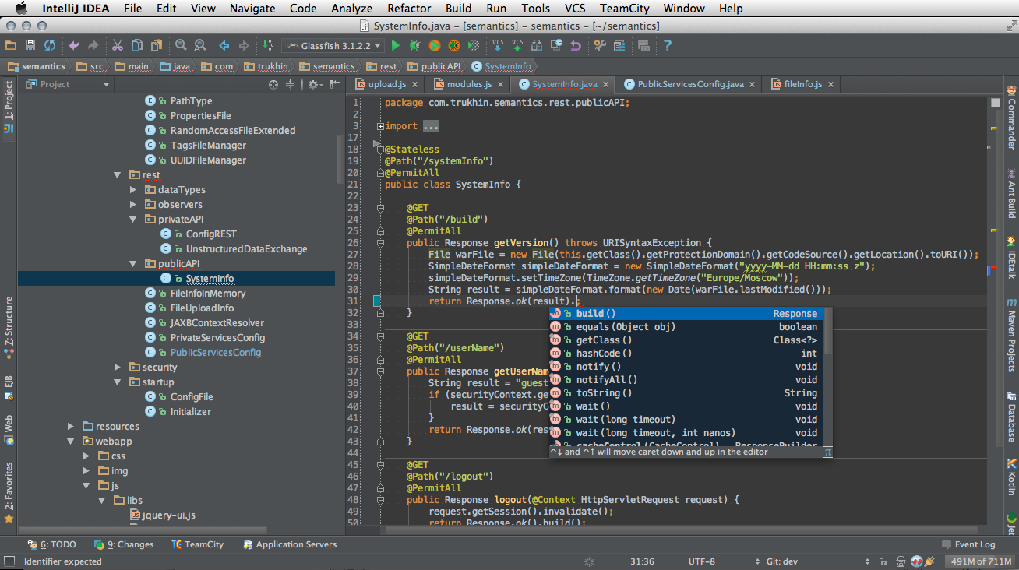
Refactoring – IDE Matters
Notes:
Not “All About IDE” because it’s also about the fear factor without a net, and about making small changes with stability in between.

Slide 64
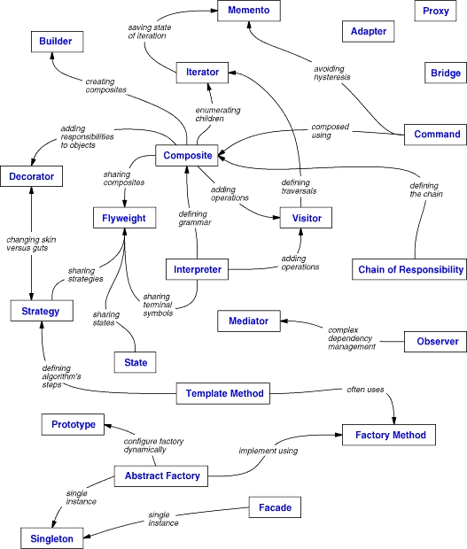
Design Patterns
A re-occurring structure in computer software that solves a basic programming problem in a specific way.
Design Patterns are given Intent-Revealing Names, so that they are memorable.
Since new problems and solutions can be discovered, these Basic 23 only represent the core of a larger set of patterns.
Notes:
Book link at the end of presentation

Slide 65
Break

Slide 66
Unit Testing
definition: Automated tests that check basic, low-level code functions.

Slide 67

UNIT TESTING
Because You Are A Professional, Not A Circus Performer.

Slide 68
Unit Test Properties
Test a single behavior of a method
Can be run automatically
Can be run independently/simultaneously
Are not dependent on outside influence (disk, network, RTL simulator, etc)

Slide 69
Unit Test Features
Typically:
Document the expected behavior of the code
Test the behavior, not the structure.
Have a single path (CCN =1)
Have a single assertion (or related assertions) (opposite: Eager Test)

Slide 70
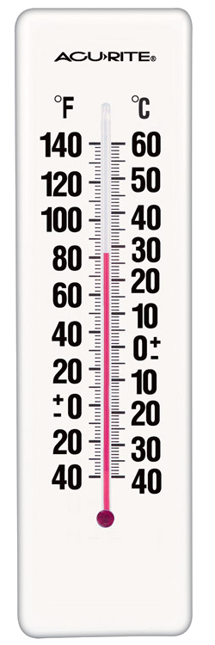
Exercise: Unit Testing
Specific pairs of inputs/outputs
What are the interesting points?
What are the assumptions about the behavior?

Slide 71
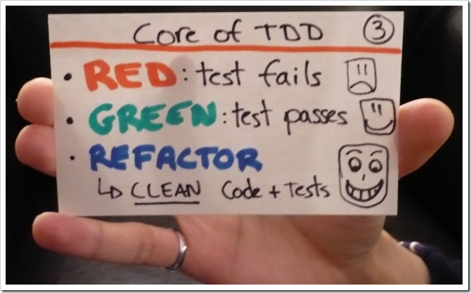
TEST-DRIVEN DEVELOPMENT
Three Easy Steps. Infinite Discipline Required.

Slide 72
Test First or Test Driven?
TDD “As If You Mean It”
Test-Driven Development
Write the RIGHT Unit Tests
Write Unit Tests First
Write Unit Tests
Notes:
TDD usually requires 3-6 months of practice to eclipse the performance of test-last/test-never coding behavior.

Slide 73
Test-Driven Development
Start by learning to write good Unit Tests
Next, write the tests before the production code
Write only the minimum code required, never more
(“What’s the simplest thing that could possibly work?”)
Learn how to refactor code to keep test passing
Finally, use the tests as executable requirements for the code to be written.
When there are no more tests to write, the code is DONE.
Red
Green
Refactor
Write the bare minimum test that shows a new small behavior that is not in the code
Write the bare minimum code to make the test pass.
Clean up the code to
Improve readability
Remove redundancy
Support the next feature

Slide 74

Group Exercise: Basic TDD
Multiple of 3: respond “Fizz”
Multiple of 5: respond “Buzz”
Multiple of 3 and 5: respond “FizzBuzz”
All other cases, respond with the number provided

Slide 75

Let’s Go Bowling!

Slide 76
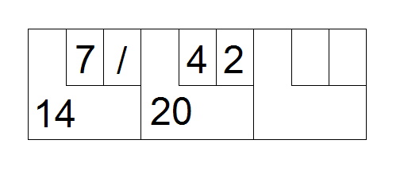
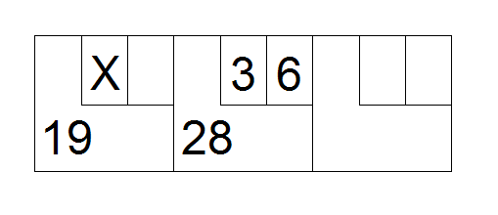
How to Score Bowling
Scoring:
One or two rolls per frame
Less than ten pins, frame score is sum of pins from both rolls
Ten pins in two rolls is a “spare”, score is 10 plus the pins score from the next roll
Ten pins in the first roll is a “strike”, score is 10 plus the pins score of the next two rolls
The last frame allows a third roll if the player scores a strike/spare
Notes:
http://en.wikipedia.org/wiki/Ten-pin_bowling

Slide 77
Bowling Kata - Instructions
Think before you write
Write the test before the production code
Keep increments small
Clean up code as necessary

Slide 78
Bowling Kata – Interface
One piece of software (class) for scoring
Pinsetter calls: void roll(int pins) – ‘pins’ knocked down
Display calls: int score(void) – returns current score
Each test will require a call to both functions; No testing internal state!

Slide 79
Coding Technical Practices
...
Short Iterations / Continuous Delivery
Pair Programming / Continuous Review
Collective Code Ownership
Test Driven Development
Refactoring
Unit Testing
Continuous Integration
Common Code Convention
Revision Control
Behaviors
Tools, Processes, Behaviors

Slide 80

Slice small to go fast
Increasing Decomposition:
Project -> Epics (by feature set)
Epics -> Stories (by complete feature)
“Elephant Carpaccio” (vertical code slice)
Notes:
http://alistair.cockburn.us/Elephant+Carpaccio

Slide 81
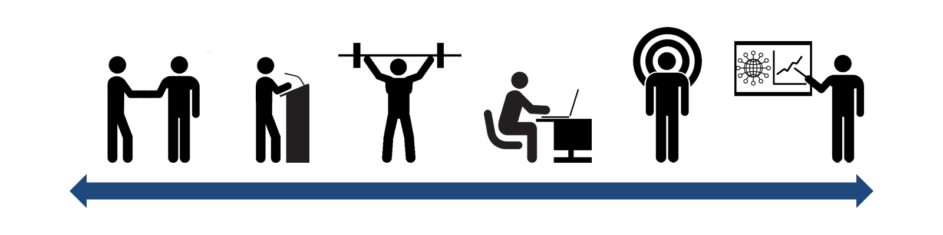
Learning Cycle
Instruction is just the starting seed
Need practice, community
Awareness Classes Practice Deploy, Mastery Teach, Connect Expand
Notes:
Typical training:
Go to long, comprehensive class
????
Profit!
Practice ideally must occur regularly to be reinforced.

Slide 82

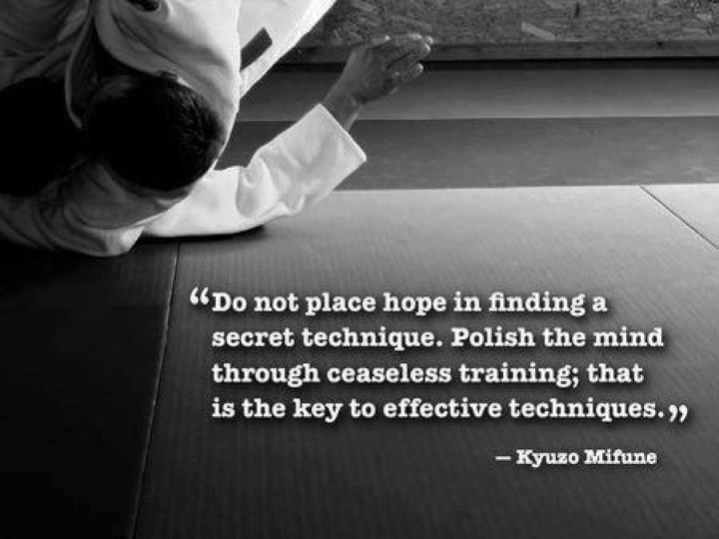
Practice, Practice, Practice
At 2-5% of total development effort
On a frequent cadence
http://goto/codedojo
Notes:
Practice ideally must occur regularly to be reinforced. Resources at: http://goto/codedojo

Slide 83
Refactoring / TDD
Hey, there are Intel classes for those!
VIDEOS:
Robert C Martin - Bad Code, Craftsmanship, Engineering, and Certification
James Shore - Let's Play TDD (serial screencast)
Misko Hevery - Unit Testing (Google Clean Code Talks)
Misko Hevery - How to Write Clean, Testable Code ( Google Clean Code Talks)
Misko Hevery - OO Design for Testability ( Google Design Tech Talks)
Gerard Meszaros - Automated Testing Patterns and Smells
Notes:
Robert C Martin - Bad Code, Craftsmanship, Engineering, and Certification
James Shore - Let's Play TDD (serial screencast)
Misko Hevery - Unit Testing (Google Clean Code Talks)
Misko Hevery - How to Write Clean, Testable Code ( Google Clean Code Talks)
Misko Hevery - OO Design for Testability ( Google Design Tech Talks)
Gerard Meszaros - Automated Testing Patterns and Smells

Slide 84
Podcast
Scott Hanselman’s Interviews: http://www.hanselminutes.com
July 2009: The Art of Unit Testing with Roy Osherove
Jan 2009: SOLID Principles with “Uncle Bob” - Robert C. Martin
Feb 2009: Uncle Bob Martin: SOLID, this time with feeling. June 2009: Working Effectively with Legacy Code with Michael Feathers
Notes:
http://www.hanselminutes.com
July 2009: The Art of Unit Testing with Roy Osherove
Jan 2009: SOLID Principles with “Uncle Bob” - Robert C. Martin
Feb 2009: Uncle Bob Martin: SOLID, this time with feeling. June 2009: Working Effectively with Legacy Code with Michael Feathers

Slide 85
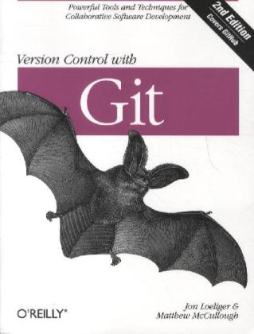
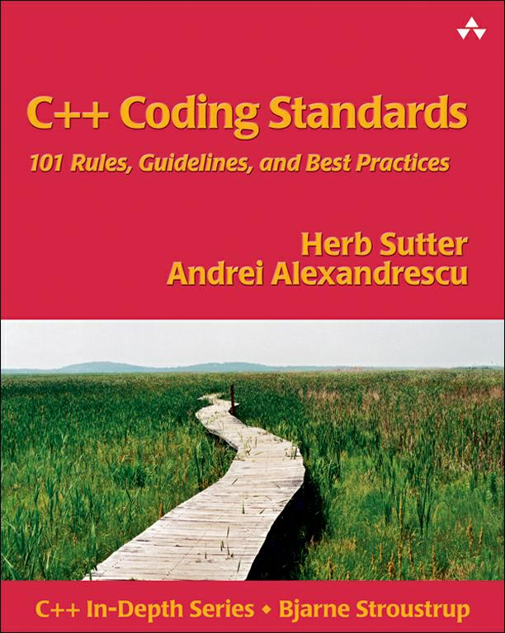
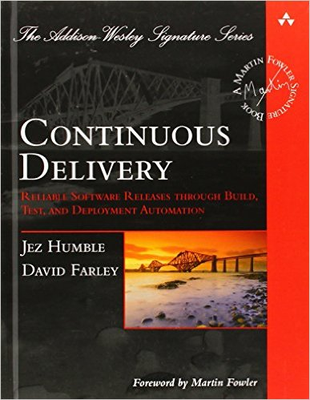
Reference Books
(all available on Safari ,
books below are Amazon links)
Notes:
http://www.amazon.com/dp/0596520123
http://www.amazon.com/dp/0321113586
http://www.amazon.com/dp/0321601912

Slide 86
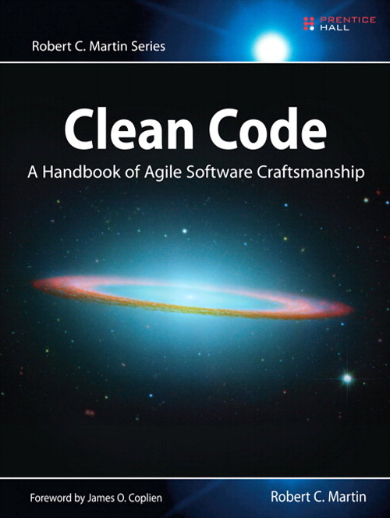

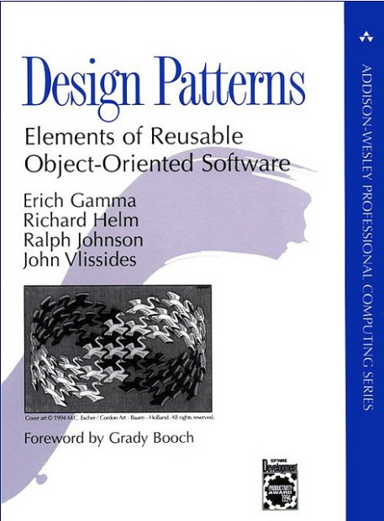
Reference Books
(all available on Safari ,
books below are Amazon links)
Notes:
http://www.amazon.com/dp/0132350882
http://www.amazon.com/dp/0321146530
http://www.amazon.com/dp/0201633612
Clean Code Cheat Sheet (handout)

Slide 87
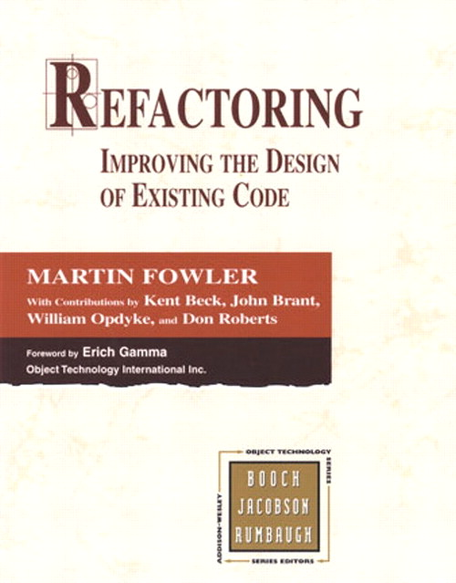


Reference Books
(all available on Safari ,
books below are Amazon links)
Notes:
http://www.amazon.com/dp/0201485672
http://www.amazon.com/dp/0131177052
http://www.amazon.com/dp/0131495054

Slide 88
Course Evaluation
On a Post-It:
Score 0-10 answering:
”Would you recommend this course to a friend?” (10 = highest)
Anything you would suggest to improve the course

Slide 89

fin
matthew.w.plavcan@intel.com
@mplavcan

